Slide 1

Rosemount 2240S
Multi-input Temperature Transmitter

Slide 2
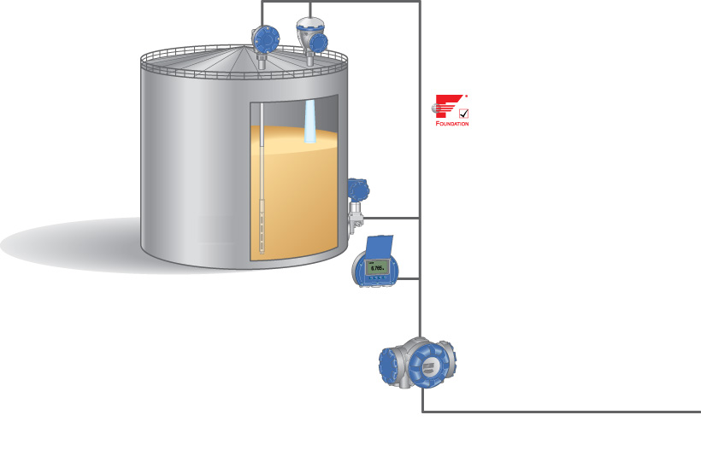
Raptor System Configuration
2240S Multi input Temperature Transmitter
5900S Radar Level Gauge
Tankbus: FOUNDATIONTM fieldbus
3051S Pressure Transmitter
2230 Graphical Field Display
2410 Tank Hub
Fieldbus

Slide 3
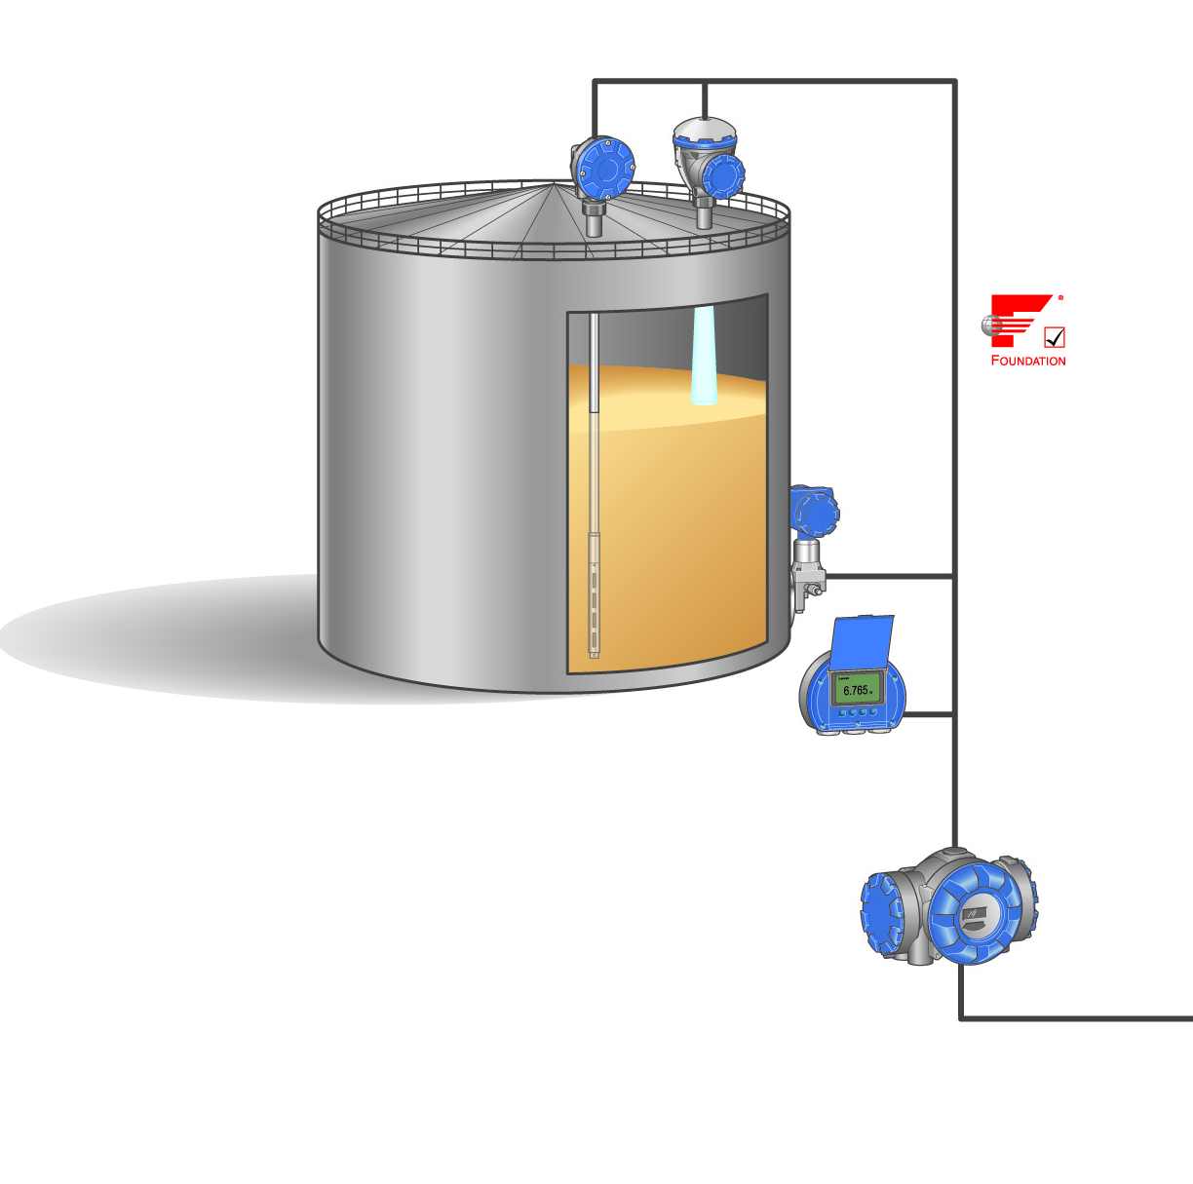
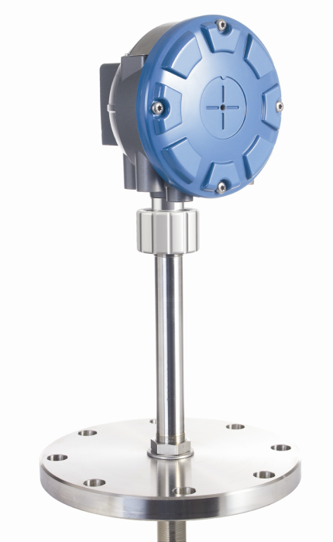
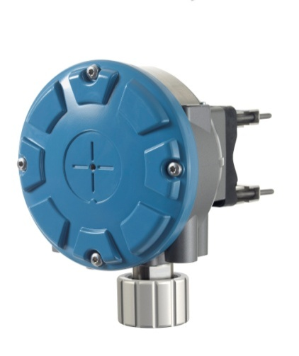
2240S Temperature Transmitter
Ultra stable temperature multiplexer
High accuracy for custody transfer applications
Up to 16 sensors
14 with FCU
Integrated digital WLS interface
Temperature measurement with 3- and 4-wire elements
Designed for use with Rosemount 565/566/765
Pt-100 & Cu-90

Slide 4
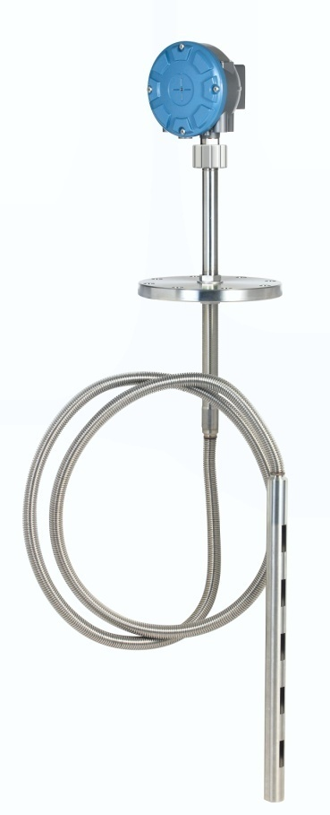
2240S Temperature Transmitter
Temperature measuring range (Pt-100)
-200 to 250 °C (-328 to 482 °F)
Temperature conversion accuracy
±0.05 °C (±0.09 °F)
Ambient Temperature effect
±0.05 °C (±0.09 °F)
Resolution
± 0.1 °C (± 0.1 °F) according to API chapter 7 and 12
Update time: 4 s

Slide 5
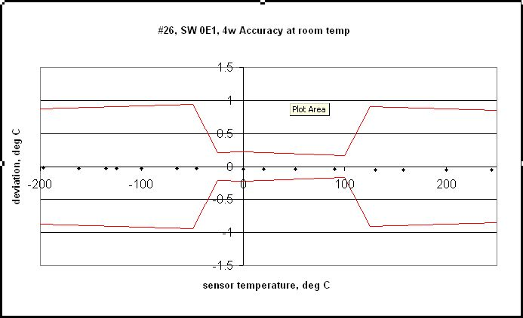

2240S Temperature Transmitter
Temperature conversion accuracy (at room temperature)
16 sensors connected in range -200 to +250 °C at room temperature

Slide 6
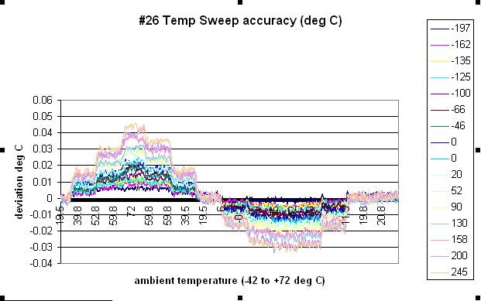
2240S Temperature Transmitter
Ambient temperature effect
Diagram shows drift with 4-wire sensors

Slide 7

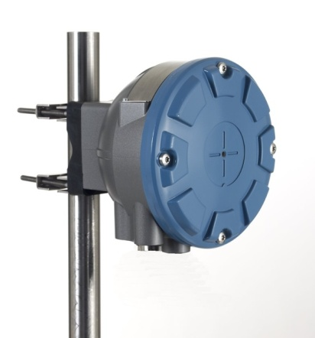
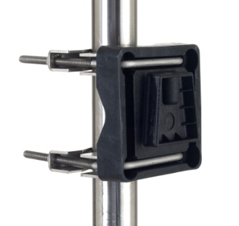
2240S Installation Considerations
Intrinsically safe
Number of RTD’s:
Up to 4 RTD’s
Up to 8 RTD’s (option)
Up to 16 RTD’s (option)
Installation options
directly on top of temperature/water level sensor
remotely on a pipe or wall
When mounted remote
cable gland possible

Slide 8
Wiring temperature elements
Three wiring types can be used:
3-wire with common return
3-wire independent spot
4-wire independent spot
 | 3-wire common return | 3-wire independent | 4-wire independent
565 | 1-16 spots | 1-16 spots | 1-16 spots
566 | 1-16 spots | 1-6 spots | 1-4 spots
765 | 1-16 spots | 1-14 spots | 1-10 spots

Slide 9
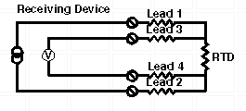
Why 4-wire?
New feature with 4-wire connection
Improved accuracy
True compensation for wiring resistance

Slide 10
Temperature accuracy impact NSV
Typical accuracy influence from 3-wire cabling is ± 0.0066 °C/m
Example
20 meter high tank
20 meter long 3-wire cabling ➔ 0,132 °C uncertainty
Tank volume 30.000 m³
Net Standard Volume NSV uncertainty from an error of 0.1°C in 3-wire vs. 4-wire cabling systems
Level @ 3.300 mm | 0.40 m³
Level @ 18.500 mm | 2.20 m³

Slide 11
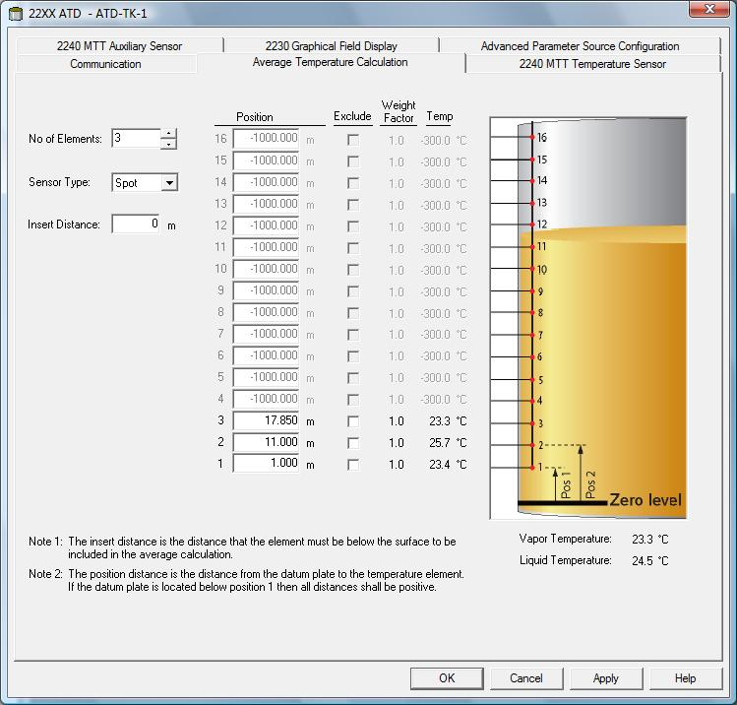
2240S Installation Considerations
Powered by 2410 via the Tankbus
Requires 30 mA
Daisy-chain connection possible
Built-in termination jumper
To be connected if required
Configured in TankMaster
Water Level Sensor calibration feature

Slide 12
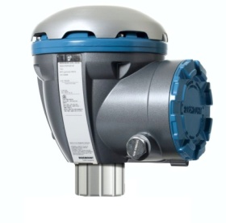
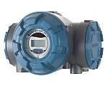
Wiring

Slide 13
Communication LED’s
Tankbus communication
Indicates transmitter connection with Tankbus
Water Level Sensor communication
Indicates connection between Water Level Sensor and 2240S
Water Level Sensor receive /transmit LEDs
Tankbus receive/ transmit LEDs

Slide 14
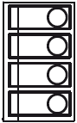
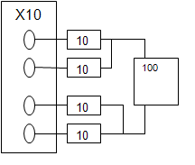
Test & Simulation of temp elements
Built-in wire resistance simulator consisting of
One 100±0.1 Ohm
Four 10±0.1 Ohm
a
b
c
d

Slide 15
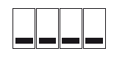
Dip Switches
Simulate temperature measurement
Write Protection
Spare
Average
Dip Switches
1 2 3 4
On
Off
Notes:
1. Simulation mode can also be achieved by doing changes in Holding Regsiter.?!?! (which holding reg?) To prevent the transmitter from being left in simulation mode it must transition from ”ON” to ”OFF” after power is applied to the transmitter. When simulation is enabled a warning Indication is set in DevicesStatus, indicating that Simulation is enabled. 2. Enables write protection of configuration data, unables unauthorized changes
3. Spare – not used 4. On: Averaging temperature (CU-90), Off: Spot temperature (PT-100)

Slide 16

Ground Leakage
Disabled
Built in ground leakage detection - jumper
If enabled
Fault in temp sensor is indicated in a status register
A single fault will affect the measurement on all channels
If disabled
Accurate measurement as long as only one fault
Multiple faults will interfere in an uncontrolled manner
Enabled
Notes:
The Rosemount 2240 has a built-in function for ground leakage detection.
When the ground leakage detector is enabled a faulty temperature sensor is
indicated in a status register. A single fault will affect the measurement on all
channels.
If one of the temperature elements fails, for example caused by a short circuit
to ground, you can change the jumper setting to disable ground leakage
detection, see Figure 6-1.
You will still get accurate measurements as long as there is only one fault.
Multiple faults will interfere in an uncontrolled manner.
NOTE!
Disabling the leakage detection can be used as a temporary solution in case
of a malfunctioning temperature element. The faulty temperature sensor must
be replaced for accurate measurement.

Slide 17
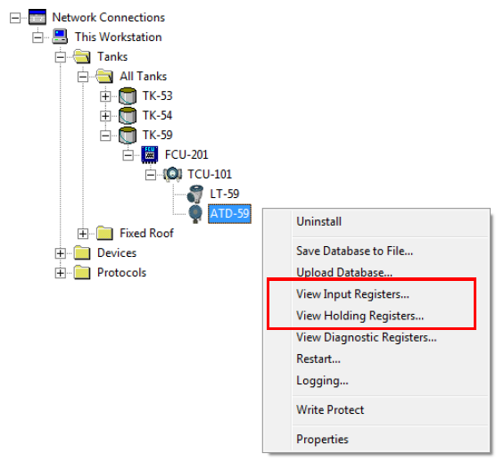
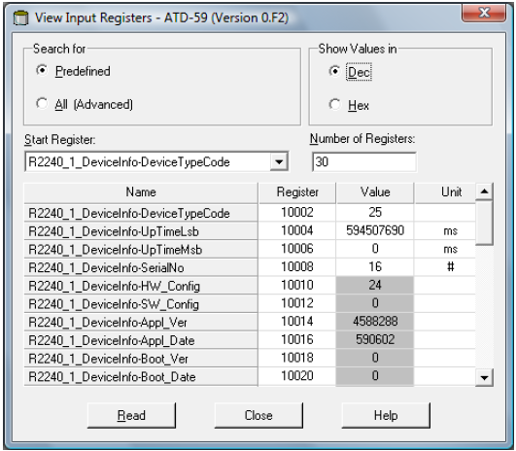
Holding & Input Registers
Holding Register
Stores various parameters, configuration data
Edit by typing in new value or change separate bits
Input Register
Stores transmitter data
Notes:
The Holding Registers store various parameters such as configuration data
used to control the measurement performance.By using the TankMaster
WinSetup configuration tool most holding registers can be edited by simply
typing a new value in the appropriate value input field.
Most Holding registers can be edited simply by typing a new value in the
appropriate Value input field. Some holding registers (marked grey in the
Value column) can be edited in a separate window. In this case you can
choose from a list of options or you can change separate data bits.
Transmitter data is stored in the Input Registers. By viewing the contents of
the Input Registers advanced users can check that the Rosemount 2240
works properly.

Slide 18
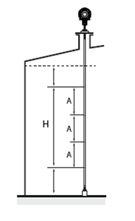
MST and API recommendations
American Petroleum Institute (API) recommends
minimum of 1 element per 3 m (10 feet) for Custody transfer applications
New API requirements coming
A = H/(N-1)
A=3
Notes:
For Custody Transfer applications, API chapter 7 recommends a minimum of
one temperature element per 3 meters (10 feet) as illustrated in Figure 3-3.
Emerson Process Management/Rosemount Tank Gauging may in some
cases recommend even more temperature elements for Custody Transfer
tanks, depending on how the tanks are operated.
Example
5 spot sensors and H=12 m.
A=12/(5-1)=3 m.
The temperature element positions are measured from the Tank Zero Level.
See the Rosemount Raptor System Configuration Manual (Document no.
300510EN) for more information about how to use the TankMaster WinSetup
software to configure temperature elements for average temperature
calculations.

Slide 19
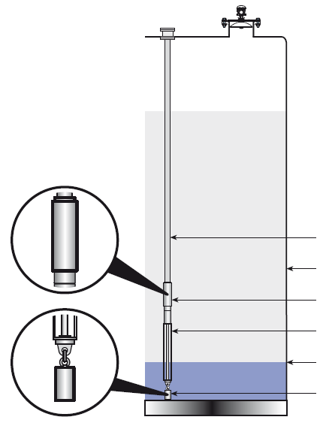
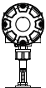
Multi Spot Temperature and Water Level Sensor
2240S
Multiple Spot Temperature sensor
Tank wall
Top weight
Water Level Sensor
Interface level
Anchor weight

Slide 20
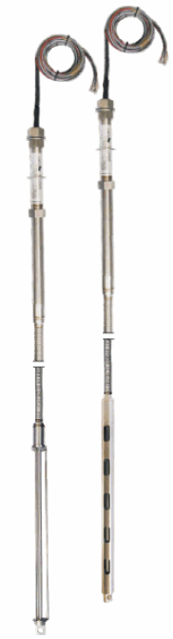
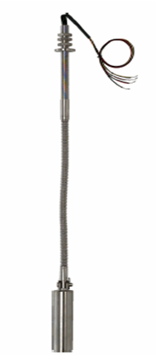
Multi Spot Temperature and Water Level Sensor
Raptor system includes three types of sensors
565, 1-16 Pt-100 spot elements
566, for LNG tanks
765, (565) with Integrated WLS

Slide 21
Multiple Spot Temperature Sensors
The Pt-100 sensors are placed inside a flexible metal SST protection tube
Special cryogenic version used for LNG
Can be installed in a closed thermowell
Service and inspections possible while the tank is in operation
Possible to set weight value for each temperature sensor
Rate certain elements more important than others and make them affect the avgerage temperature more
Primarily used for LPG

Slide 22
Multi Spot Temperature spec Rosemount 565, 566, 765
Sensor accuracy
1/6 DIN Class B (standard)
1/10 DIN Class B (option)
Liquid temp range
-50 to 250 °C (-58 to 482 °F)
-170 to 100 °C (-274 to 212 °F) for cryogenic use
Configuration
Rosemount TankMaster WinSetup is recommended
Overall length is 5-70 m (16-230 ft)

Slide 23
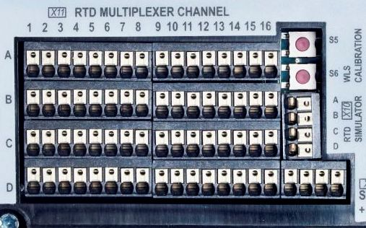
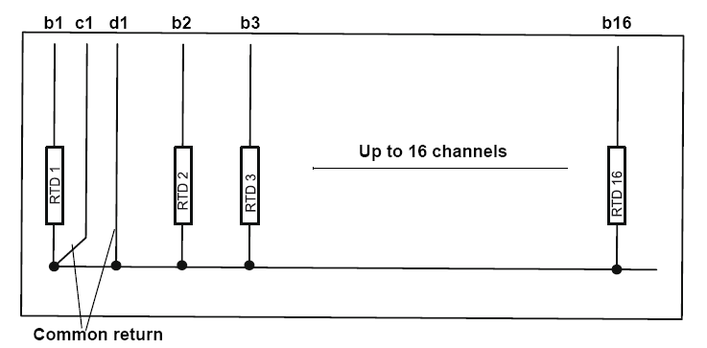
Connection of sensor to 2240S
3-wire with common return
b, c & d
NOT in a

Slide 24
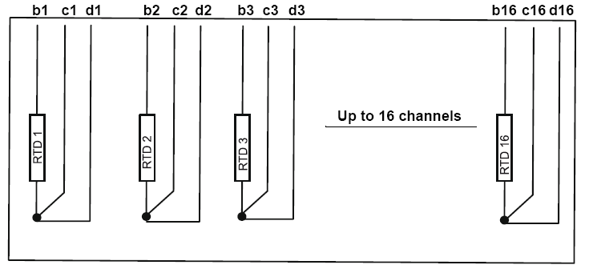
Connection of sensor to 2240S
3-wire independent
b, c & d
NOT in a

Slide 25
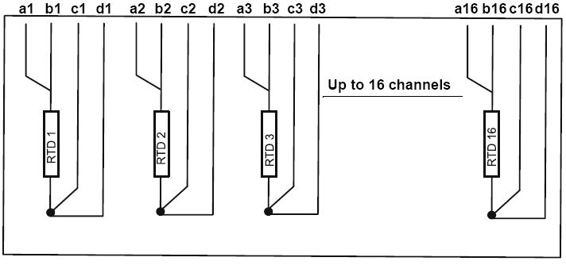
Connection of sensor to 2240S
4-wire independent

Slide 26
765 Water Level Sensor
Capacitive sensor
Digital communication with 2240S over RS485
Product calibration on tank with 2240S
Two versions
Open
Suitable for crude oil applications
Closed
Suitable for lighter fuels such as diesel oil etc

Slide 27
Water Level Sensor, specification
Active length:
500 mm
1000 mm (option)
Accuracy
± 2 mm (500 mm version)
± 4 mm (1000 mm version)
Repeatabillity
± 0,5 mm (500 mm version)
Operating temperature
0 to +120 °C (+32 to +250 °C)
Operating Pressure
0 to 4 Bar (0-58 Psi)

Slide 28
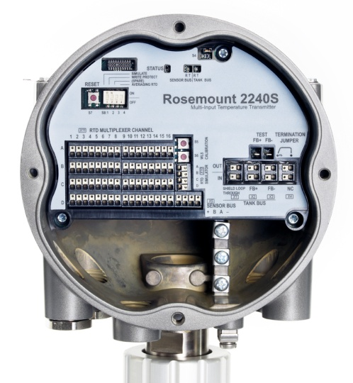
765 sensor connection to 2240S
Wire color:
Red: +
Green: B
White: A
Black: -
Connect the cable shield to one of the three ground terminals
Connection points for Water Level Sensor cable shield

Slide 29
Water Level Sensor calibration
Factory calibrated for use in diesel, ε_{r}=2.3
Parameters stored during calibration
Full = measured capacitor value when probe is completely covered with water
Empty = measured capacitor value when probe is completely covered with reference product
Can be calibrated in field using Rosemount 2240S

Slide 30

WLS Calibration – How to do
Lift up WLS from bottom of tank and make sure the sensor is covered only with product
Wait 5 min
Press zero button three seconds to begin calibration
Wait for the status LED to turn from steady light to normal LED status (2 sec. interval)
When calibration process completed, firmly anchor WLS back to the bottom of the tank
Status Led
Zero button
Notes:
To calibrate the Water Level Sensor:
1. Lift the Water Level Sensor from the bottom of the tank and make sure
the sensor is covered only with product.
2. Wait five minutes.
3. Press the ZERO button on the Rosemount 2240 for three seconds to
begin calibration (see Figure 5-3).
4. Wait for the Status LED to turn from a steady light to normal LED status
(2 sec. interval). Calibration error is indicated by blinking at a high
frequency.
5. When the calibration process is completed, anchor the Water Level
Sensor to the bottom of the tank.

Slide 31
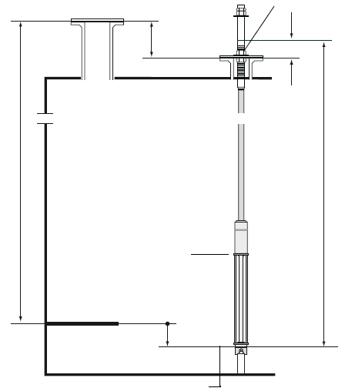
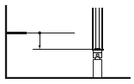
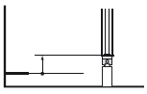
WLS Reference Point
Two reference points
Upper sensor limit
Water Zero Level
Marked on the probe
Level offset (X) has to be considered
X=(R-L1)-(L-L2)
Tank Reference Point
Mark
L1
Upper reference Point
L2
R
L
Upper Sensor Limit (100%)
Tank Zero Level
Level offset X
Water Zero Level
X > 0
X < 0
Lower Sensor Limit (0%)
Notes:
Configuration
To convert from the reference system of the water level sensor (WLS) to the
reference system of the tank, the distance X needs to be calculated by using
the following formula:
X = (R-L1) - (L-L2).
X = Distance between the Tank Zero Level and the Water Zero Level.
L = Distance between Water Zero Level and mark on the upper part of the WLS.
R = Tank Reference Height. This is the distance between the Tank Reference Point and the Tank Zero Level.
L1=distance between the Tank Reference Point and the temperature sensor flange.
L2=distance between the mark on the top of the WLS and the temperature sensor flange.
The conversion from the WLS reference system to the tank reference system
is handled by the Rosemount 2240. In the tank reference system, the Lower
Sensor Limit (0%) and the Upper Sensor Limit (100%) are given by the
following formulas:
Upper Sensor Limit (100%) = LA + X
Lower Sensor Limit (0%) = X
where LA is the active length of the Water Level Sensor, and X is the distance
between the Water Zero Level and the Tank Zero Level (Minimum Water
Distance), see examples in Table 5-2 on page 5-10.

Slide 32
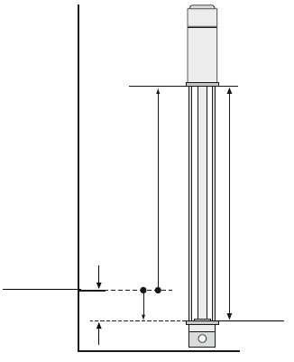
WLS Configuration example 1
The Water Zero Level is below the Tank Zero Level
Lower sensor limit (0%) is below tank zero level
X < 0
LA=500mm, X=-50mm
0% = -50mm
100% = 500+(-50)=450mm
100%
X < 0
L_{A}
Tank Zero Level
X
Water Zero Level
0%
Notes:
The Water Zero Level is below the Tank
Zero Level.
In this case the Lower Sensor Limit (0%)
on the WLS is below the Tank Zero Level.
Note that when the Lower Sensor Limit
(0%) is below the Tank Zero Level this
results in X<0.
Example:
LA=500 mm, X= -50 mm.
LSL (0%)= -50 mm.
USL(100%) = 500 + (-50)=450 mm.

Slide 33
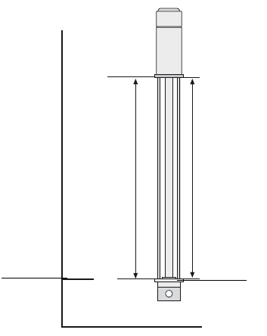
WLS Configuration example 2
The Water Zero Level is equal to Tank Zero Level
Lower sensor limit (0%) corresponds to tank zero level
X = 0
LA=500mm, X=0mm
0% = 0mm
100% = 500+0=500mm
100%
X < 0
L_{A}
Tank Zero Level
Water Zero Level
X
0%
Notes:
The Water Zero Level is equal to the Tank
Zero Level.
In this case the Lower Sensor Limit (0%) on
the WLS corresponds to the Tank Zero
Level.
Example:
LA=500 mm, X=0 mm.
LSL (0%) = 0 mm.
USL (100%) = 500 mm.

Slide 34
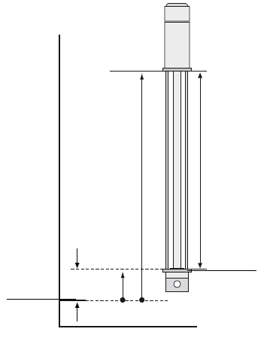
WLS Configuration example 3
The Water Zero Level is above the Tank Zero Level
Lower sensor limit (0%) is below tank zero level
X > 0
LA=500mm, X=70mm
0% = 70mm
100% = 500+70=570mm
100%
X < 0
L_{A}
Water Zero Level
Tank Zero Level
X
0%
Notes:
The Water Zero Level is above the Tank
Zero Level.
In this case the Lower Sensor Limit (0%)
on the WLS is above the Tank Zero Level.
Note that when the Lower Sensor Limit
(0%) is above the tank Zero Level this
results in X>0.
Example:
LA=500 mm, X=70 mm.
LSL (0%) = 70 mm.
USL (100%)= 500 + 70=570 mm.

Slide 35
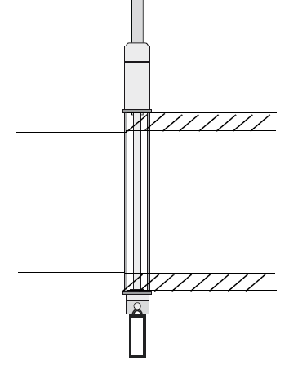
Upper and lower dead zone
Upper and lower dead zone
Distance on the top and bottom of the sensor excluded from the measurement due to contamination
Upper Measurement Limit
Upper Dead Zone
Lower Measurement Limit
Lower Dead Zone
Notes:
Upper and lower Measurement Limit
The Upper Measurement Limit and the Lower Measurement Limit are
obtained using the following formulas:
Upper Measurement Limit (100%) = (LA + X) - UDZ
Lower Measurement Limit (0%) = X + LDZ,
where UDZ is the Upper Dead Zone and LDZ is the Lower Dead Zone.
SKALL SLIDE BORT?
ÄR DET NÖDVÄNDIGT ATT VISA?
TIDIGARE(SAMT SENARE) SLIDE TAR UPP LEVEL-OFFSET

Slide 36
Troubleshooting
Problem | Cause | Solution
No communication with TTM using FF bus | Bad Cabling | Check cables
 | No or too many terminations | Make sure that the last device on the tankbus has a termination. There is one internal termination located on the TTM
Impossible to change configuration (write to HR) | TTM is write protected | Check HW write protection switch. Remove SW write protection in WinSetup.
Invalid measurement | Bad RTG cabling or configuration | Check the temperature status bits.
Strange values in FF paramteres (using FF DD) | FF implementation is currently limited. | Use Tank hub with WinSetup for TTM configuration or FF using lemur .
WLS shows saturated value | The data (WLS lower sensor limit is not correctly stored in the WLS | Update the WLS database or disable the upper and lower deadzone detection.

